Slide 1
Coma
Dr Rashmi Kumar
Pediatric Intensivist
University of Nairobi

Slide 2
Definitions
Consciousness is a state of awareness of self and surrounding
Mental status = arousal + content

Slide 3
Anatomy of mental status
Ascending reticular activating system (ARAS)
Activating systems of upper brainstem, hypothalamus, thalamus
Determines the level of arousal
Cerebral hemispheres and interaction between functional areas in cerebral hemispheres
Determines the intellectual and emotional functioning
Interaction between cerebral hemispheres and activating systems

Slide 4
The content of consciousness
Sum of patient’s intellectual (cognitive) functions and emotions (affect)
Depends upon the activities of the cerebral cortex, the thalamus & their interrelationship
Lesions of these structures will diminish the content of consciousness (without changing the state of consciousness)

Slide 5
Altered mental status
Abnormal change in level of arousal or altered content of a patient's thought processes
Change in the level of arousal or alertness
inattentiveness, lethargy, stupor, and coma.
Change in content
“Relatively simple” changes: e.g. speech, calculations, spelling
More complex changes: emotions, behavior or personality
Examples: confusion, disorientation, hallucinations, poor comprehension, or verbal expressive difficulty

Slide 6
Definitions of levels of arousal (conciousness)
Alert (Conscious) - Appearance of wakefulness, awareness of the self and environment
Lethargy - mild reduction in alertness
Obtundation - moderate reduction in alertness. Increased response time to stimuli.
Stupor - Deep sleep, patient can be aroused only by vigorous and repetitive stimulation. Returns to deep sleep when not continually stimulated.
Coma (Unconscious) - Sleep like appearance and behaviorally unresponsive to all external stimuli (Unarousable unresponsiveness, eyes closed)

Slide 7
Confusional state
Major defect: lack of attention
Disorientation to time > place > person
Patient thinks less clearly and more slowly
Memory faulty (difficulty in repeating numbers (digit span)
Misinterpretation of external stimuli
Drowsiness may alternate with hyper -excitability and irritability

Slide 8
Delirium
Markedly abnormal mental state
Severe confusional state
PLUS
Visual hallucinations &/or delusions
Patient not in true contact with people or surroundings

Slide 9
For coma to occur:
Lesions of the cerebral hemispheres and brainstem to be extensive

Slide 10
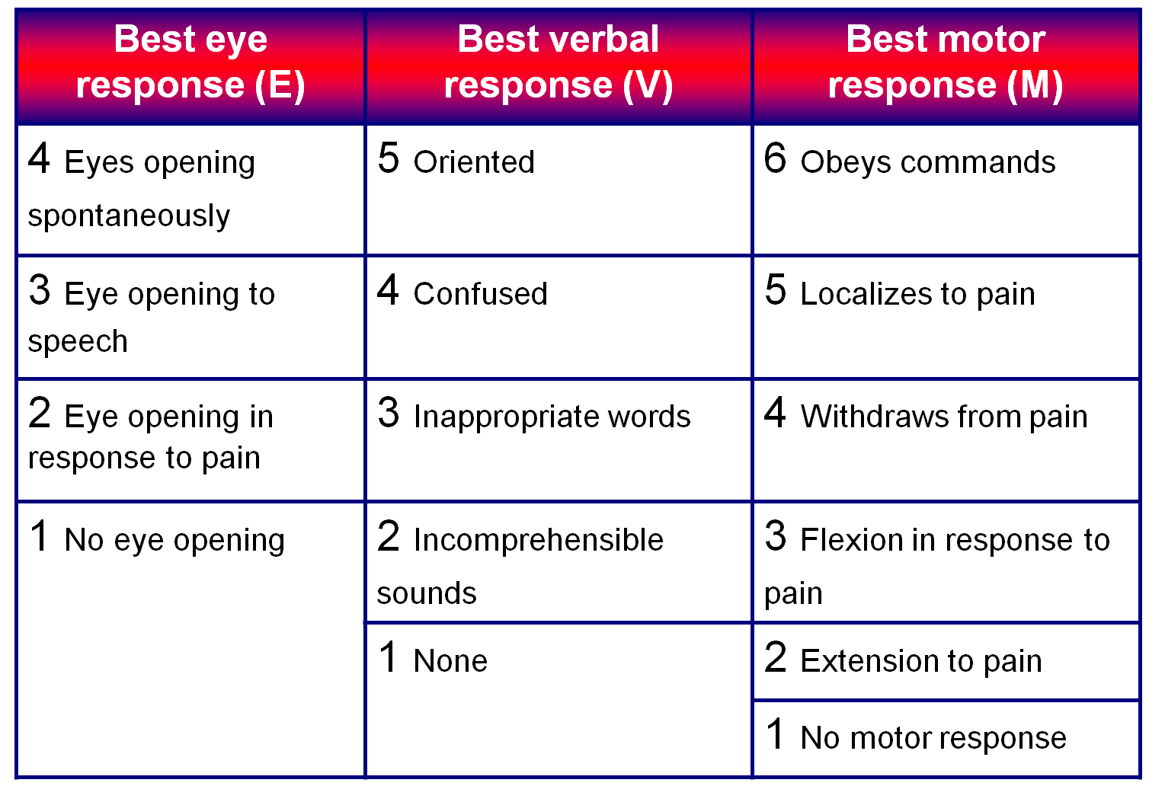
Glasgow Coma Scale

Slide 11
Generally, comas are classified as:
Severe, with GCS ≤ 8
Moderate, GCS 9 - 12
Minor, GCS ≥ 13.

Slide 12
Main causes of coma
Cerebrovascular diseases
Hypotension
Raised ICP
Infections
Shock
Metabolic and endocrine
Electrolyte abnormalities
Drugs and toxins

Slide 13
Investigations
Depends on:
History
Differential diagnosis
Routine examinations to rule out common causes

Slide 14
Management of the unconscious patient
Treatment of the underlying cause
Maintenance of normal physiology: respiration, circulation, and nutrition
Focus on A,B,C and causes, care to include all organ systems.

Slide 15
Prognosis in coma
In general, coma carries a serious prognosis.
This is dependent to a large extent on the underlying cause.
Coma due to depressant drugs carries an excellent prognosis
Metabolic causes, apart from anoxia, carry a better prognosis than structural lesions and head injury

